Slide 1
Introduction to Computer Architecture and Organization (UCS510)

Slide 2
What is Computer Architecture ?
Answer : It is the study of computers ?
Computer Architecture
The view of a computer as presented to software designers
Computer Organization
The actual implementation of a computer in hardware.

Slide 3
What is Computer Architecture ?
Computer Architecture
Computer architecture is concerned with the structure and behavior of the computer as seen by the user. It includes the information, formats, the instruction set, and techniques for addressing memory.
Computer Organization
Computer organization is concerned with the way the hardware components operate and the way they are connected together to form the computer system.

Slide 4
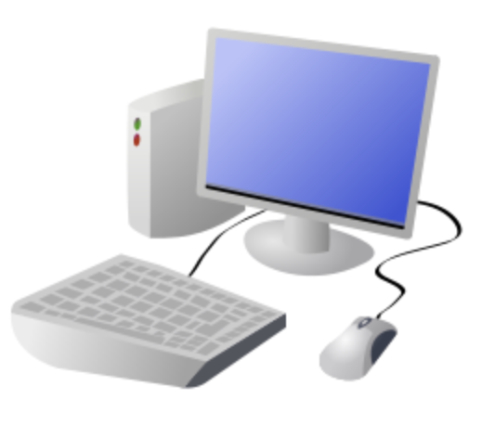

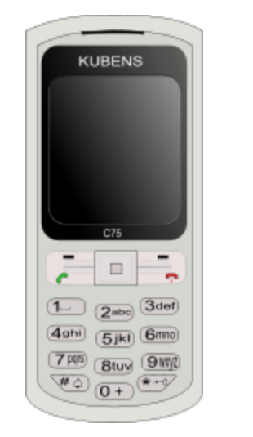
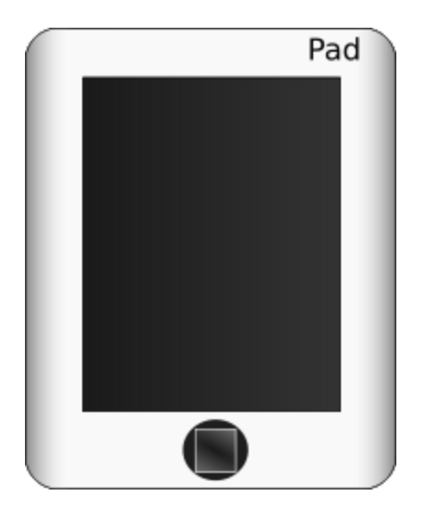
What is a Computer ?
A computer is a general purpose device that can be programmed to process
information, and yield meaningful results.

Slide 5
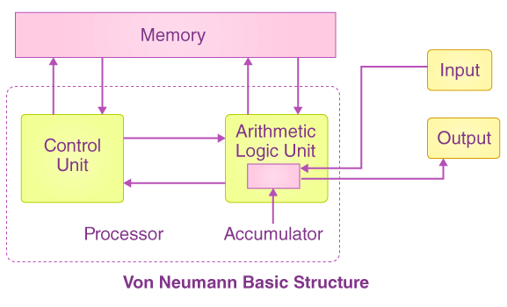
How does it work ?
Program – List of instructions given to the computer
Information store – data, images, files, videos
Computer – Process the information store according to the instructions in the program

Slide 6
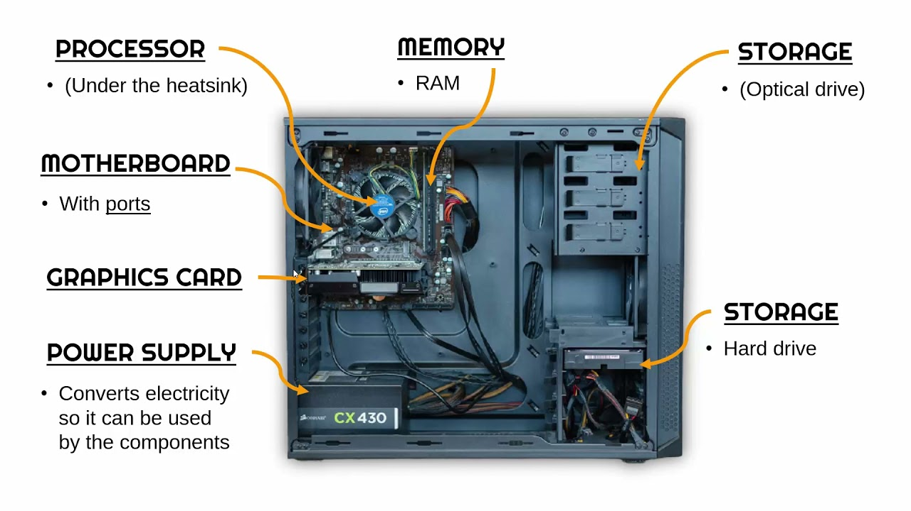
What does a computer look like ?
Let us take the lid off a desktop computer

Slide 7
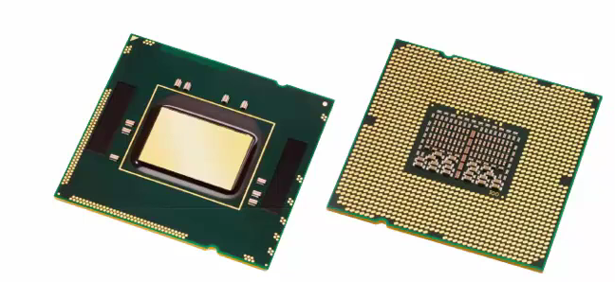
What does a processor look like ?

Slide 8
Memory
Hard disk
CPU
Memory – Stores programs and data. Gets destroyed when the computer is powered off
Hard disk – stores programs/data permanently

Slide 9
Let us make it a full system ...
Memory
Hard disk
CPU
Keyboard
Monitor
Mouse
Printer

Slide 10
Books
Introduction to Microprocessor Based Systems Design
Text Books:
Mano, Morris M., Computer System Architecture, Prentice Hall (1991) 3rd ed.
Hayes, J.P., Computer Architecture and Organization, McGraw Hill (1998) 3rd ed.
Reference Books:
Hennessy, J.L., Patterson, D.A, and Goldberg, D., Computer Architecture A Quantitative Approach, Pearson Education Asia (2006) 4th ed.
Leigh, W.E. and Ali, D.L., System Architecture: software and hardware concepts, South Wester Publishing Co. (2000) 2nd ed.

Slide 11


